Slide 1

Equity in Postsecondary Education for Students with Disabilities
University of Hawaii-Manoa, Center for Disability Studies: Jin Hye-Park, Kiriko Takahashi
Northern Arizona University, Institute for Human Development: Ronda Jenson, Sakenya McDonald, Kelly Roberts
University of Nevada-Reno, Nevada Center for Excellence in Disabilities: Randall Owen

Slide 2

Transition from High School to Postsecondary
Kiriko Takahashi & Hye Jin Park
Center on Disability Studies, University of Hawaii at Manoa

Slide 3
Projects for Postsecondary Transition
Pacific Alliance
Students with disabilities
Transition elements: mentoring; self-advocacy; career interest building (internships); college transition support; basic mathematics, reading and writing
Ka Pilina: AIM Together
Mentoring and role models
STEM interest building activities – focus on math
Project TEAMS
Twice exceptional students
Mentoring – disability & STEM topics
Service learning
Community involvement
Native Hawaiian students
STEM academic enrichment – focus on science
College transition support

Slide 4
Project Twice Exceptional students Achieving and Matriculating in STEM (TEAMS)

Slide 5
Project TEAMS
Funded by the U.S. Department of Education
Goal: To increase the number of high school students with disabilities identified as “scientifically promising” who
(1) demonstrate high levels of science achievement
(2) intend to or actually enter a postsecondary program in either science, technology, engineering, or mathematics.
Period: October 2014 – March 2021
Locations: Hawaii, New York, Iowa, Arizona, CNMI, American Samoa

Slide 6
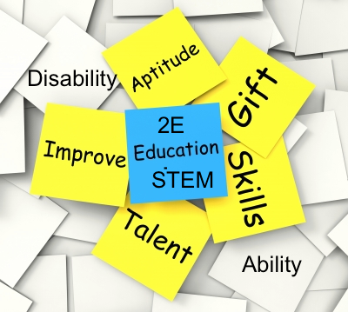
Background issues
Students with disabilities are underrepresentation in
    gifted education and STEM fields.
There are not clear definition of twice-exceptional students, so the exact prevalence is not known.
Notes:
Students with disabilities are traditionally underrepresented in both gifted Education (Nicpon, Allmon, & Sieck, 2011) and STEM fields (Metcalf, 2012; NSF, 2013).
Unlike the case with underrepresented groups in those fields (e.g., culturally diverse students, economically disadvantaged students, or females), the exact prevalence of twice exceptional students
is not known (Nicpon, Allmon, & Sieck, 2011) because there is no clear definition of gifted students with disabilities.

Slide 7

Untapped STEM talent
Daily challenges of living with a disability fosters creative thinking to solve problems, adapt to new circumstances, and accomplish tasks.
Dispositions of successful individuals with disabilities
  High levels of commitment
  Turn challenges into opportunities
  Seek innovative solutions to problems
Notes:
In confronting the daily challenges of living with a disability, individuals with disabilities must apply creative thinking to solve problems, adapt to new circumstances, and accomplish tasks. As a result of disability-related experiences, they have developed valuable thinking dispositions that lead to innovation and varied approaches to achieving success (Department of Labor, 2013).
Successful individuals with disabilities invest high levels of commitment toward their goals, turn challenges into opportunities, and seek innovative solutions to problems (Denhardt, 2008; Force, 2007; Gerber, 2002; Seymour & Hunter 1998), which are essential dispositions of scientifically promising individuals.

Slide 8
Student Identification
Project TEAMS purposely broadens the inclusion criteria to include a much greater range of students regardless of their current performance.
STEP 1: Identify incoming 10th, 11th, and 12th graders with disabilities who have received a grade of C or better in a STEM subject.
STEP 2: With the pool of the students from STEP 1,
Self-nomination using MIDAS,
Teacher-nomination using SIGS-SCHOOL, and/or
Parent-nomination using SIGS-HOME ratings (i.e., SIGS).
Screened 1,809 students who met the first criteria (students with disabilities having a C or higher on science subjects) for their potential and aptitude in science.
The number of participants who met the two identification criteria and completed the full program was 500, including 333 in the intervention group and 167 in the comparison group.

Slide 9
TEAMS Model & intervention
Mentoring on Disability + STEM Topics
based on the
Pacific Alliance
Model
Academic Enrichment
based on the Renzulli Model
College Transition Support
based on the
Pacific Alliance Model

Slide 10
Component 1: Academic Enrichment
Based on Renzulli Enrichment Triad Model, the activities were developed to:
allow students to explore their areas of interest in their preferred ways of learning
help build necessary skills to grow as an independent researcher by gradually releasing the responsibility of learning to students
provide an opportunity to conduct their own research, share it with a public audience in their preferred ways of expression, and receive feedback
Notes:
Twice-exceptional students need differentiated and enriched academic experiences in the area of their interest to fulfill their potential.
The enrichment activities need to:
allow students to explore their areas of interest in their preferred ways of learning
help build necessary skills to grow as an independent researcher by gradually releasing the responsibility of learning to students
provide an opportunity to conduct their own research, share it with a public audience in their preferred ways of expression, and receive feedback

Slide 11

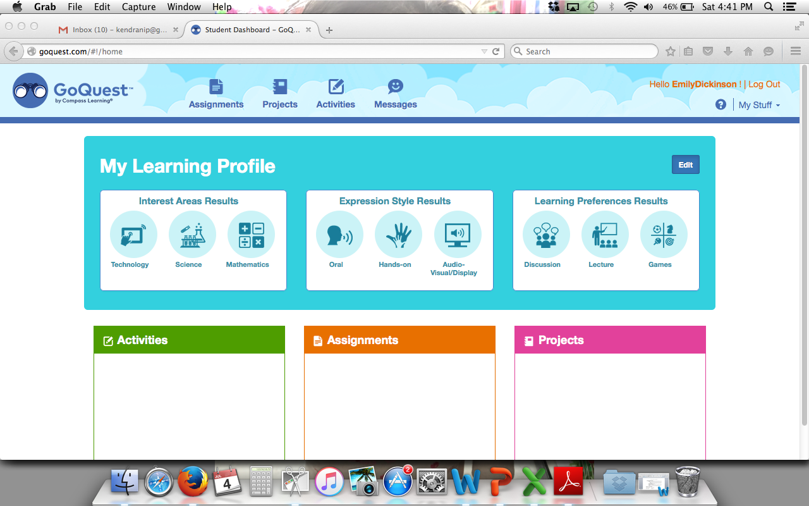
Student Independent Research
Based on Their Own Learning Profiles
Renzulli Learning.com
Notes:
One of the first things that our students do is to get to know themselves better through their individual student profile using Renzulli Learning program. Through this profile, they become more aware of their top three interest areas, learning preferences and how they like to express what they know.
Using the resources, differently provided in alignment with their own learning preferences by the program, students explore topics of interest in STEM and build thinking skills.

Slide 12
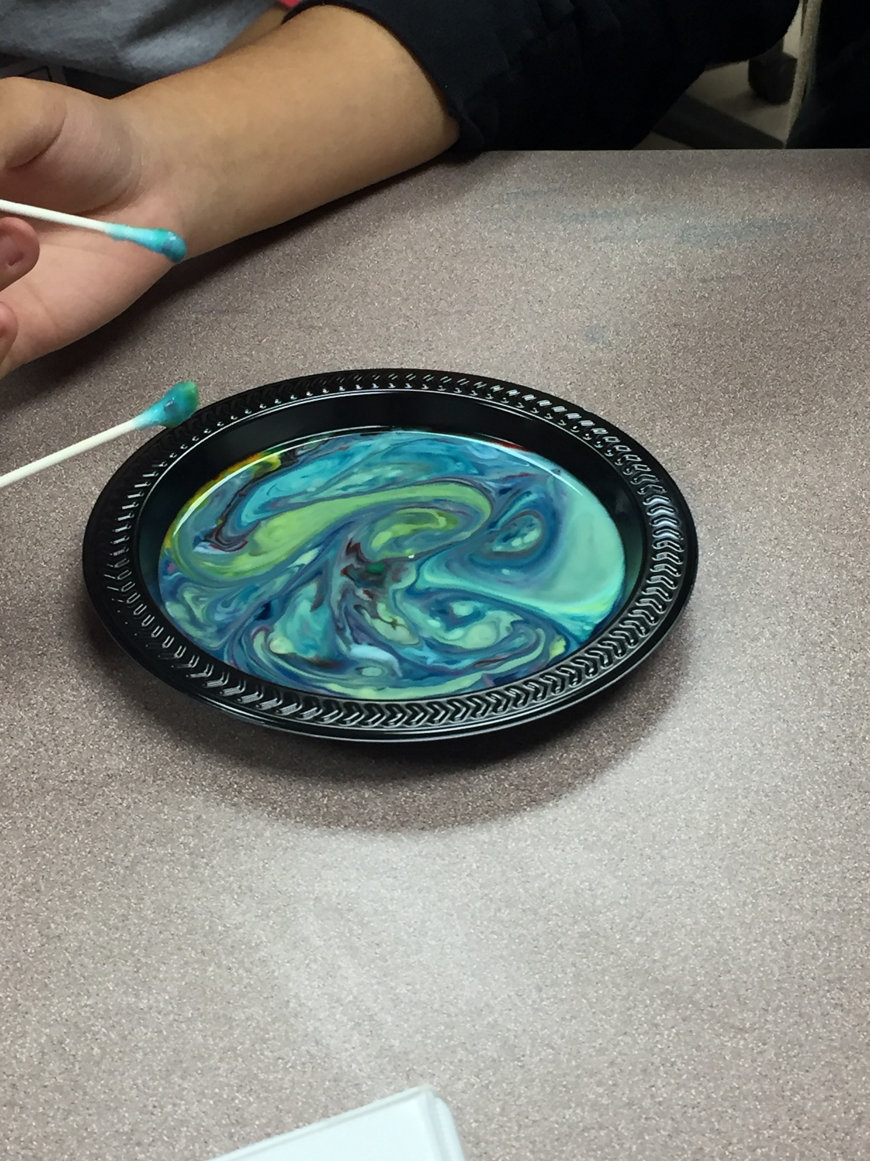
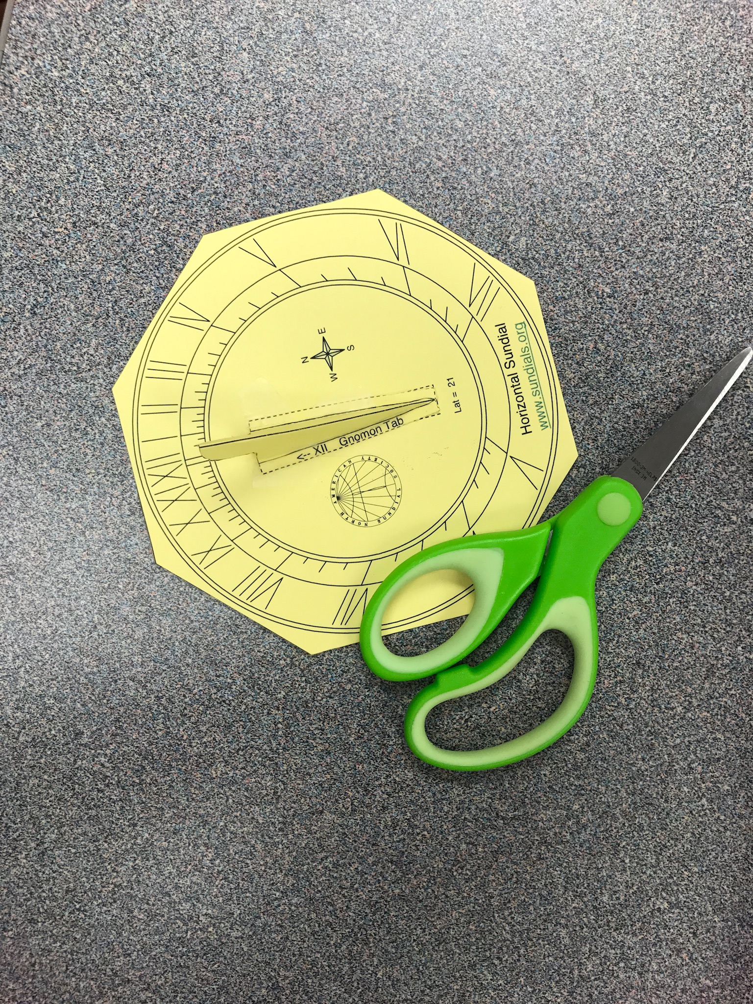
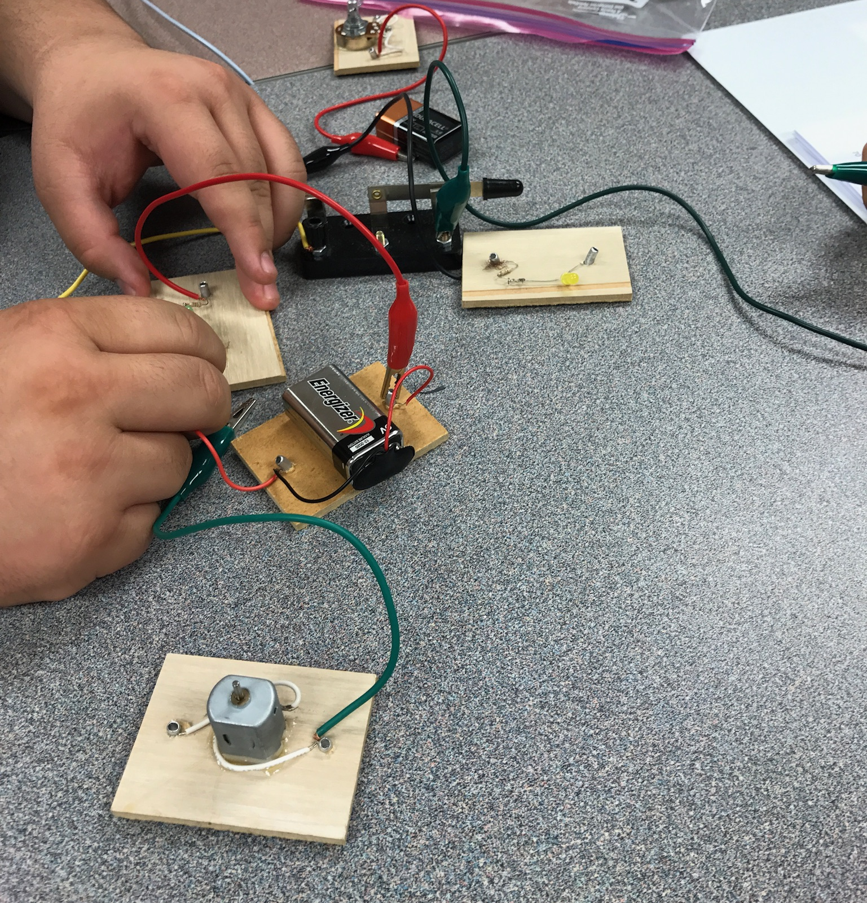
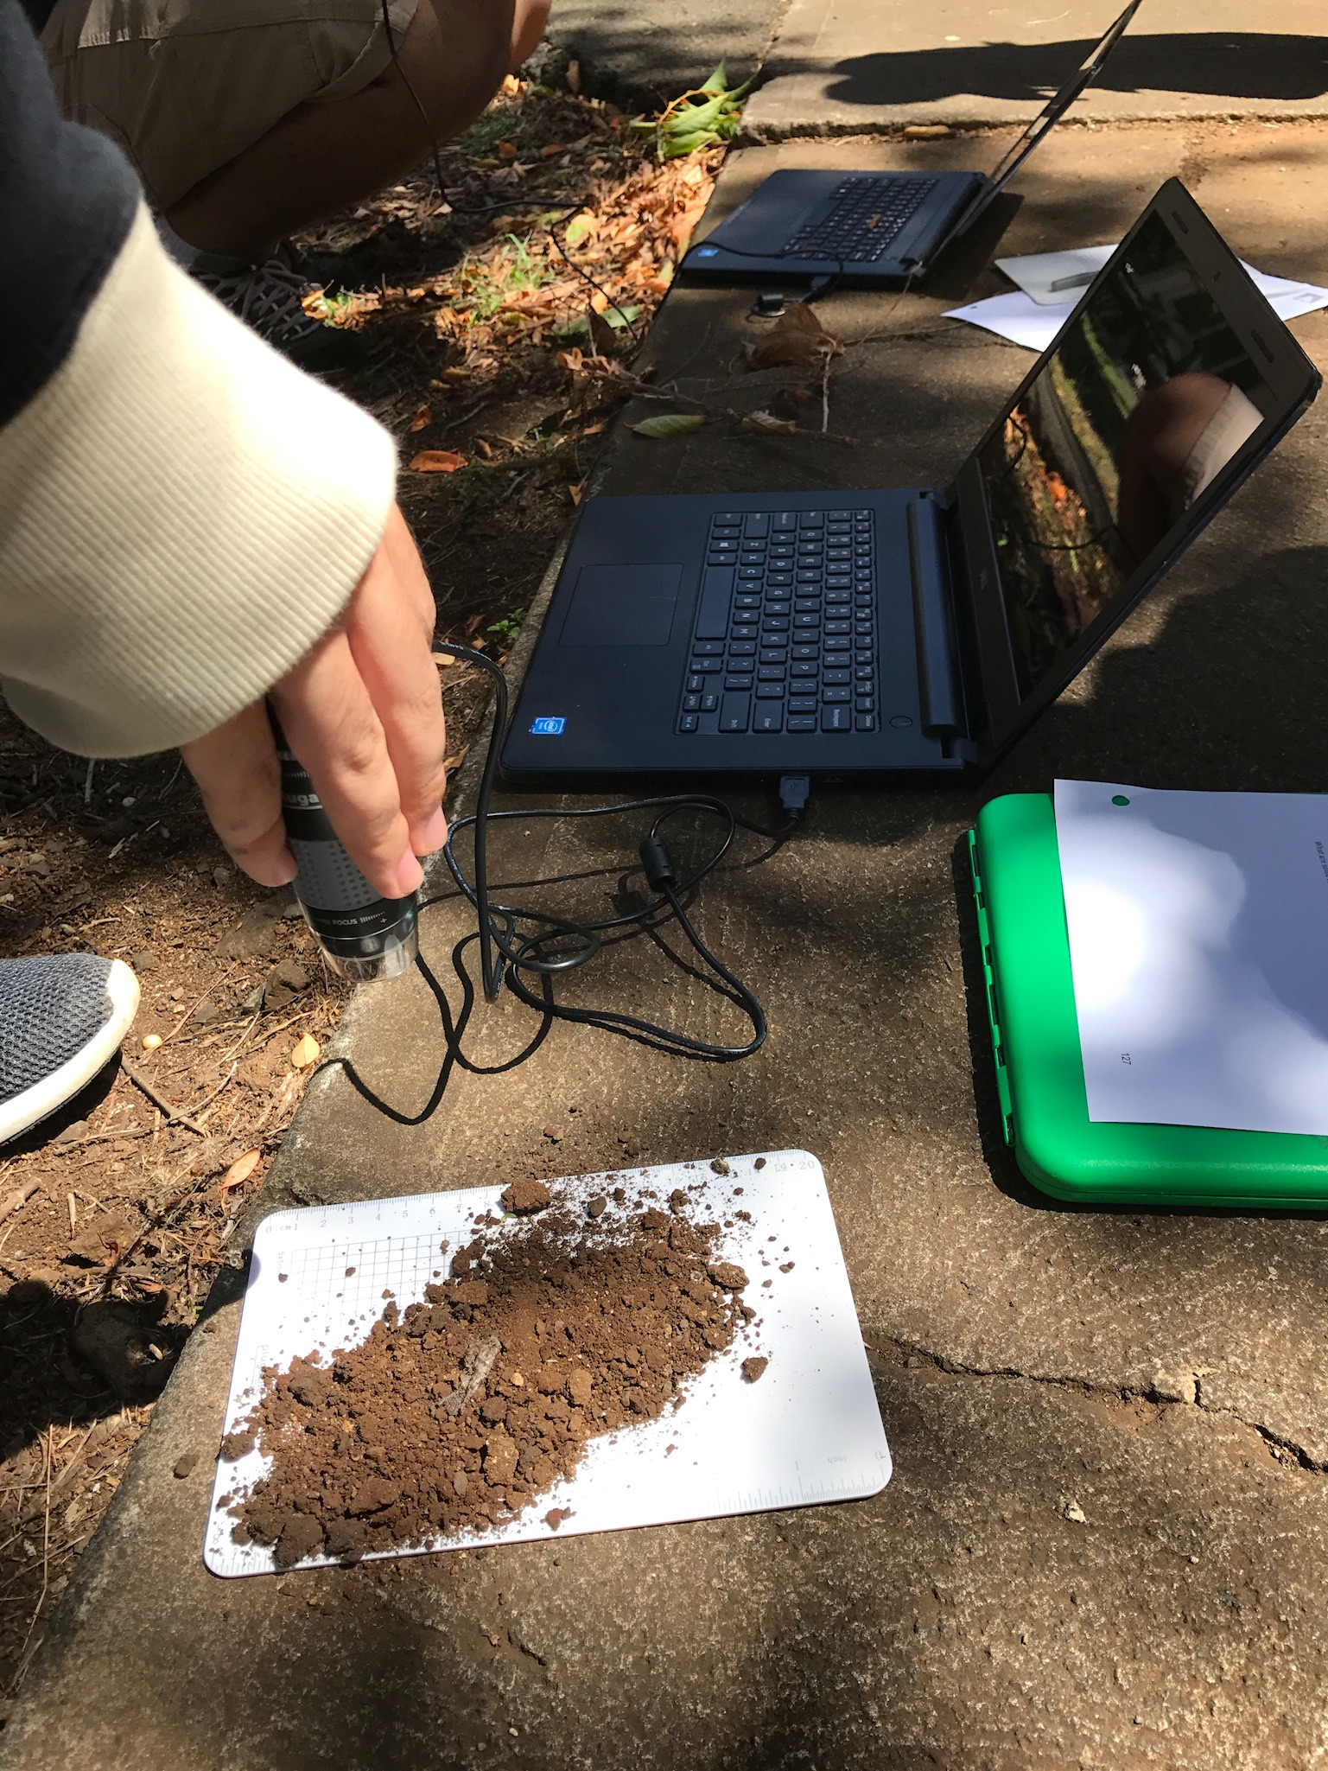
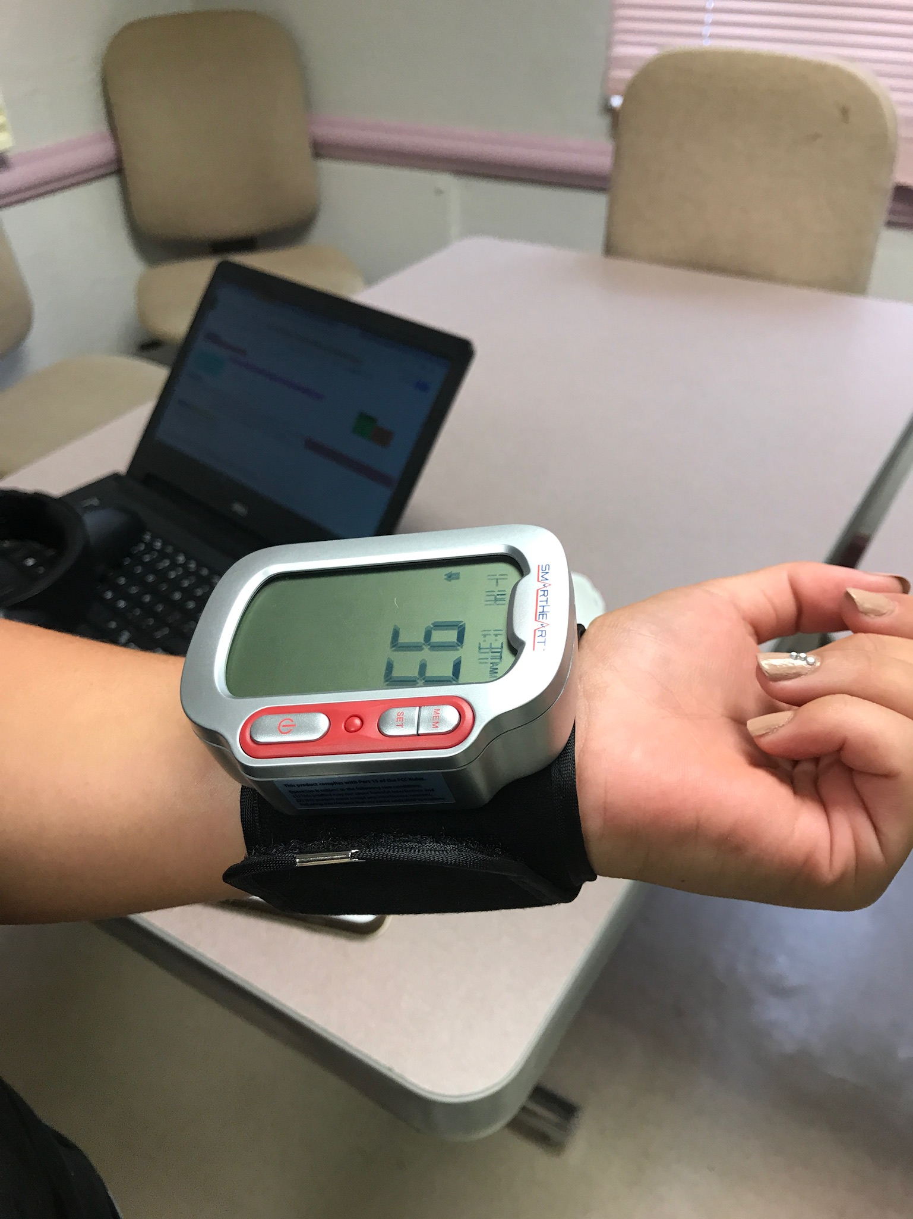
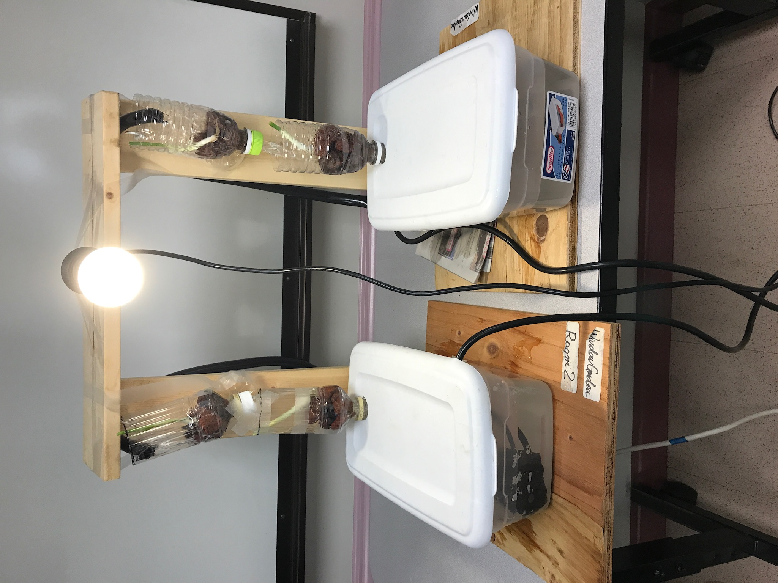
Science Hands on Activities
Chemistry
Astronomy
Circuits
Soil Science
Health Science
Window Garden
Notes:
In addition, students improve their scientific thinking skills as doing 6 hands-on activities in the fields of chemistry, astronomy, circuits, soil science, health science and window garden or sustainability.

Slide 13
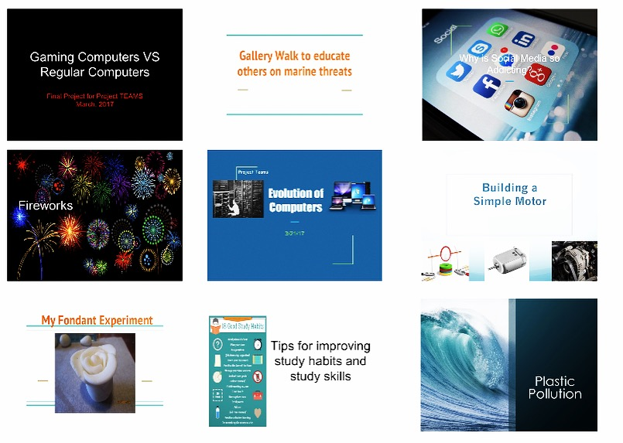
Independent Science Projects
Notes:
Then, they are guided to decide a specific topic area and carry out their independent science project. Then, students present their projects in a way that best fits to their personal expression style.

Slide 14
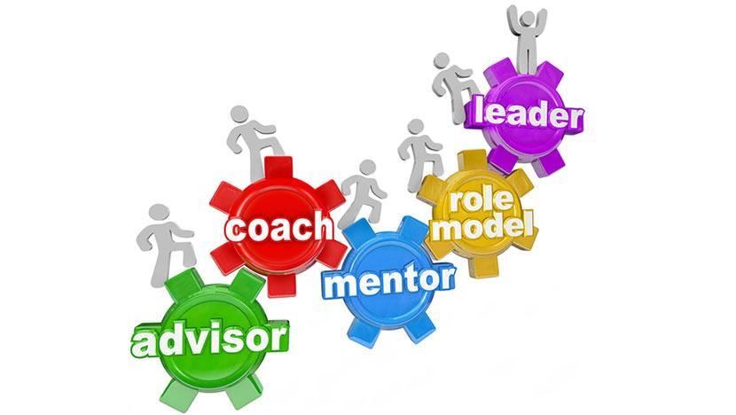
Component 2: Mentoring
Purpose
Students learn more about their own disability and improve their interest in the STEM fields by learning how to set goals and advocate for themselves and other related topics.
http://www.ceracycloan.co.uk/upcoming-events/mentoring/
Notes:
As the second component, Project TEAMS offers mentoring on disabilities and workshops to build students interest in STEM fields.

Slide 15
Session Topics
Goal-Setting
Self-Advocacy
What Does a Scientist Look Like?
STEM Career Exploration
Internships in STEM
https://choosework.ssa.gov/blog/2017-10-14-disability-mentoring-day
Notes:
On the screen is a list of some of the topics we discussed under the mentoring component. As you can see, these sessions are designed so that students learn more about their own disability and improve their interest in the STEM fields by learning how to set goals and advocate for themselves and other related topics.

Slide 16

Example
Self-Advocacy
At college-different experiences from high school
Becoming their own self-advocates
  Understand one’s own needs & being able to explain needs to others
  Request accommodations
    i.e., visit Kokua program at UH Manoa
Notes:
Here is one mentoring session example.
Once they leave high school, students with disabilities no longer have the same guarantees to special education and accommodations that they had in high school.
Instead, students need to be their own self-advocates and disclose their learning and attention issues in order to receive accommodations in college.
So, the self-advocacy lesson guides students to understand the differences between high school and college and learn about college student services and disability services.
The mentor facilitates students to understand one’s own needs, explain those needs to others, and request reasonable accommodations.

Slide 17

Component 3: College Transition
Purpose
Provide students with early awareness of the benefits of continuing their education by enrolling in college and college application process.
Image: http://www.mcdowelledu.org/college-transition.html
Notes:
The third component is college transition support.
The purpose is to provide students with early awareness of the benefits of continuing their education by enrolling in college and college application process.

Slide 18
Session Topics
Introduction to College
Personal Statements
STEM College Programs
Study Skills
Scholarships
Disability Services in College
Assistive Technology
Resume Building
Interview Skill Building
https://www.ncmich.edu/resources-support/other-support/institutional-data-center/college-going-behavior.html
Notes:
TEAMS students participate in college transition workshops such as introduction to college, study skills, college disability services and resources, resume building and more.

Slide 19

Example
Scholarships
Knowing annually awarded by U.S., State governments and private corporations
FAFSA (Free Application for Federal Student Aid)
  Talk to a transition counselor at high school
Image: http://www.mcdowelledu.org/college-transition.html
Notes:
As an example of college transition session, students learn about and explore available scholarships for students with disabilities and start to fill out the FAFSA application. They also learn how to talk and ask for help to a transition counselor at high school.

Slide 20
Community of Practice
Administrators
Parents
Special Education Teachers
Community of Practice
Disability and Gifted Education Specialists
Transition Coordinators
Science Teachers
Notes:
At each intervention we have a Community of Practice. COP members include school administrators, special education teachers, transition coordinators, science teachers, disability and gifted education specialists, and parents. The COP plays an important part in identifying specific school and participants' needs related to the project, developing a school-based project implementation plan, supporting project implementation at the school, and participating in evaluating students' final projects.

Slide 21
Student Demographics
63.28% of the participants are male
28% speak other than English at home
70% of students’ parents did not have any college experiences.
84% of students did not know anyone who was working or studying in the STEM fields.
Among those who revealed a disability type,
  37.9% learning disabilities;
  23.1% ADD/ADHD;
  10.3% Asperger’s/Autism Spectrum Disorder;
  9.2% speech impairment;
  7.2% psychological disorder;
  4.6% blind/visual impairment;
  3.1% intellectual disability;
  2.6% health impairment; 1% TBI; 0.5% physical disability; and 0.5% deaf/hard of hearing.

Slide 22
Findings
Statistically significant improvement in
  Students’ attitude toward school
  attitudes towards STEM
  achievement in science
  level of STEM identity development
  intention to enroll in postsecondary STEM programs
Summative portfolio assessment: As comparing students’ grade-level peers (i.e., standards of excellence) and their own baseline performance (i.e., standards of growth), mentors evaluated that TEAMS group students have adequately progressed toward both standards.
Final product and presentation evaluation: Final showcase audience (mentors, teachers, and administrators) evaluated that students produced quality products and presentations (esp. statement of purpose, problem focusing, and time, effort, and energy).

Slide 23
Supporting Inclusive Practices in Colleges (SIP-C)
An Exemplary Model for Students with Intellectual and Developmental Disabilities in Postsecondary Education Settings
Dr. Kelly Roberts, Principal Investigator
Dr. Sakénya McDonald, Program Director

Slide 24
Justification
Individuals with I/DD often exit high school without having developed the skills necessary to successfully pursue meaningful, integrated employment and independence.
The opportunity to participate in postsecondary education (PSE) can empower persons with disabilities to:
develop academic competencies and knowledge;
improve their prospects in the job market;
hone their social skills;
and broaden their views of the world (Baum, Ma, & Payea, 2013).

Slide 25
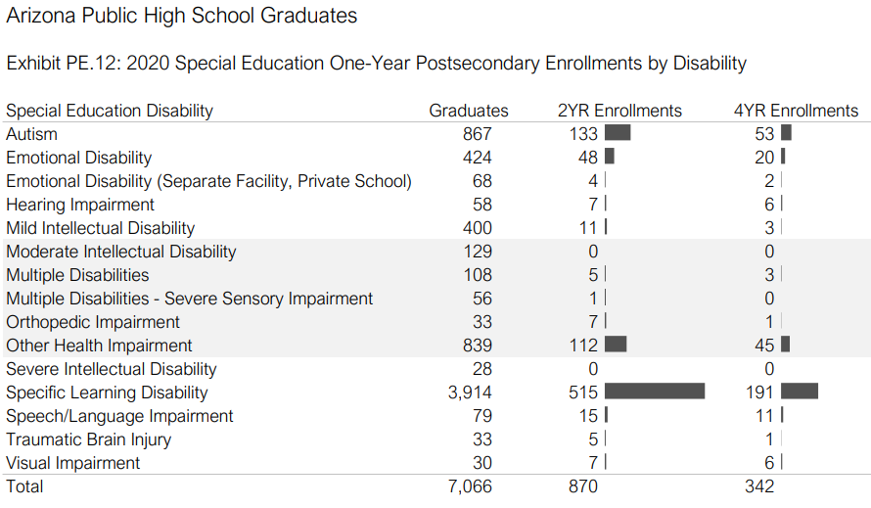
Arizona PSE Data (2020-21)

Slide 26
Philosophy
If students with intellectual and/or developmental disabilities self determine their education and employment goals and have access to supports to realize these goals in authentic inclusive and age-appropriate environments, these students will achieve significantly improved transition and employment outcomes.

Slide 27
Core Values
“Front Door First”
“Set the Bar High”
Self-advocate and utilize campus resources before seeking specialized services
Improve socialization skills
Decreases campus-wide stigmas
Self-determine postsecondary goals
Develop soft-skills
Practice taking positive risks

Slide 28
Strategy Areas
Person-centered planning
Self-Determination
Self-Advocacy
Dual Enrollment
Collaborative Teaming
Adaptive Educational Coaching
Peer Mentoring
Personal Technology support
Career Coaching
Professional Development

Slide 29
Fast Facts
University of Hawai’i (CDS) Model
US Department of Education (Federal, 2.4M)
Arizona Developmental Disabilities Planning Council (State, $300K)
53,076 square miles, including The Navajo Nation
  Northern Arizona University (UCEDD) – 4 yr university
  Coconino Community College – 2 yr
  Mohave Community College – 2 yr
  Northland Pioneer College – 2 yr

Slide 30
YTD Progress
32 participants
10 pending applications
3 Campus Coordinator/ADEs
2 ADEs
5 Peer Mentors
3 trainees
1 Graduate Intern
Interagency Collaborative Team (59 members)
22 Student-Centered Activities
778 hours (direct contact)
5 PD events

Slide 31
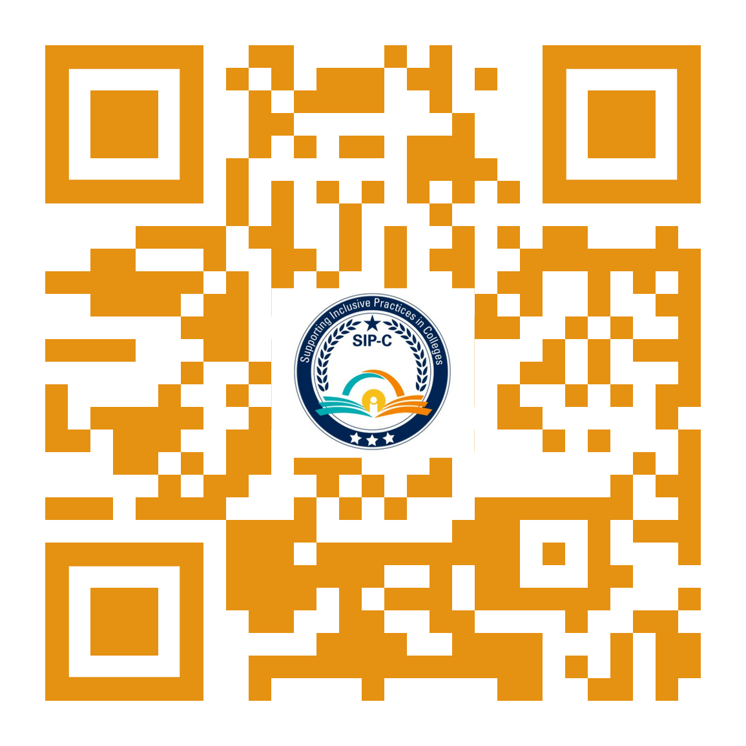
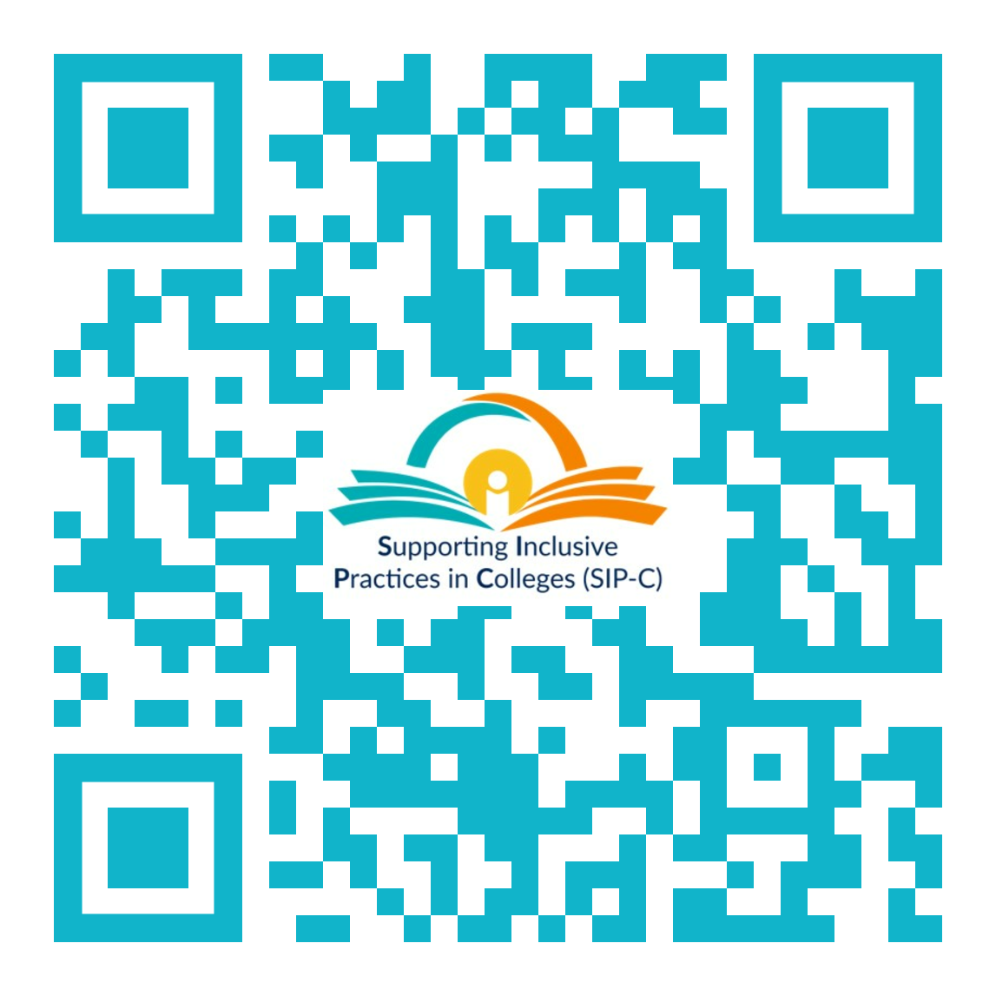
Learn More
Follow Us:
Information Request:

Slide 32

Disability as Diversity: Postsecondary Perspectives
Ronda Jenson, Ph.D.
Institute for Human Development
Northern Arizona University

Slide 33



National Science Foundation Funding for this work
NSF INCLUDES Planning Grant
Research Synthesis of Effective Inclusion Practices for Neurodiverse K-12 Learners in Informal STEM Learning Contexts
NSF INCLUDES Alliance: The Alliance of Students with Disabilities for Inclusion, Networking, and Transition Opportunities in STEM (TAPDINTO-STEM)
NAU: Mountain Hub Lead
Supported by the National Science Foundation under NSF Award #2040736 (NSF INCLUDES Planning Grant), Award # 2115542 (NSF AISL Grant), and subaward to Award #2119902 (NSF INCLUDES Alliance). Any opinions, findings, and conclusions or recommendations expressed in this material are those of the author(s) and do not necessarily reflect those of the National Science Foundation.
Notes:
Recognition of NSF awards
Brief description of projects and data informing this presentation
Recognition of project partners

Slide 34
Presentation Contents
Diversity, Equity, and Inclusion at Postsecondary Institutions
Definitions of STEM and Neurodiversity
Perspectives of Neurodiverse Students

Slide 35
Disability/Neurodiversity and DEI
Early stages of a review of university diversity, equity, and inclusion (DEI) strategic plans
Reviewed the DEI strategic plans for the 25 TAPDINTO-STEM partners
6 mention of disability in their DEI definition

Slide 36
Diversity Strategic Plan Example: NAU
The complexity of personal experiences, values, and worldviews that arise from differences and intersections of culture and circumstance. Such differences and intersections include race, sex, ethnicity, age, religion, language, ability/disability, sexual orientation, gender identity and expression, socioeconomic, veteran or other status, or geographic region.

Slide 37

Broad definition of Stem
Fields of study and work that incorporate elements of science, technology, engineering, and/or math

Slide 38
What is neurodiversity?
Natural human variation
Neurodivergence is diversity
Neurodivergent thinking includes
  autism,
  many forms of learning disabilities such as dyslexia,
  conditions that affect focus and maintaining engagement often referred to as attention deficit disorders, and
  sometimes mental health conditions such as anxiety and depression
Notes:
Defining DYNA STEM and neurodiverse learners (define). What is meant by advantage?
Person-first/Identify-first language, neurodiversity is considered a natural, human variation

Slide 39
Neurodiversity in Postsecondary STEM Coursework
Interviews with 21 neurodiverse college students in STEM majors at 3 colleges.

Slide 40
Neurodiverse students tell us they want…
Specific, clear instructions
Flexibility for self-guided learning
Balance of peer learning, hands-on, and direct instructions (aka-not just lecture or not just group project)
Choice: Options to choose and not choose activities or steps
Visuals and graphics, not just text-based
Notes:
10 items. How many of those 10 items are also good for you?

Slide 41
Neurodiverse students tell us they want…
Opportunities to be creative
Clear, logical applications to real-world STEM work
Sensory stimuli focused on specific tasks
Physical space options for standing and sitting, with options for orientation in the space
Clear social expectations
Notes:
10 items. How many of those 10 items are also good for you?

Slide 42


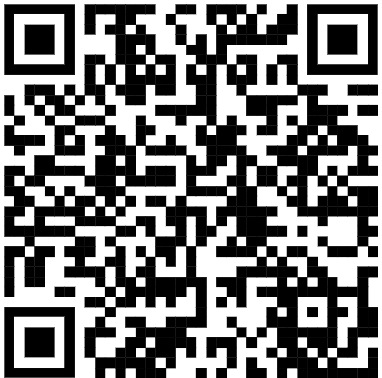
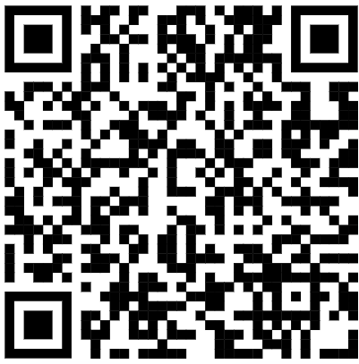
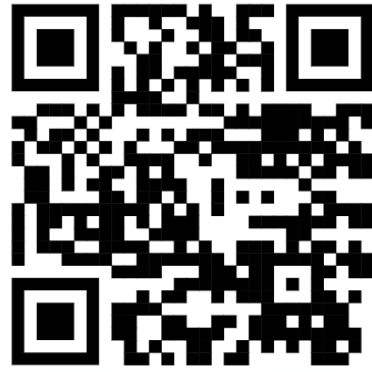
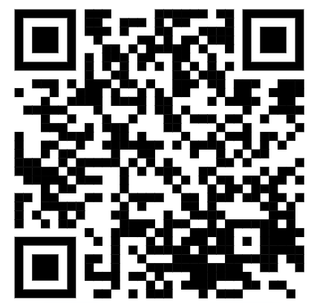
Contact information
Ronda Jenson, PhD Ronda.Jenson@NAU.edu
@rondajenson
https://www.linkedin.com/in/rondajenson
Resources
NSF INCLUDES Coordination Hub
NAU News
TAPDINTOSTEM
https://news.nau.edu/jenson-ihd-stem/
https://nau.edu/nau-research/stem-fields/
https://tapdintostem.org/
https://www.includesnetwork.org/

Slide 43
Discussion
1. In what ways has the field of postsecondary education made strides in valuing students with disabilities and what are the persistent gaps or inequities that continue to be issues?
2. When considering the whole student, what are the ideas for improving the range of resources available to students?
3. Where does disability fit within postsecondary diversity, equity, and inclusion (DEI) strategic plans?

