Slide 1
Engaging Neurodiverse College Students Effectively
Ronda Jenson, Ph.D.
TAPDINTO-STEM
Northern Arizona University
Scott Bellman
Neuroscience for Neurodiverse Learners
University of Washington
AAC&U Conference on Diversity, Equity, and Student Success
March 11th, 2023
Notes:
RONDA

Slide 2
TAPDINTO-STEM and NSF INCLUDES
The Alliance for Students with Disabilities for Inclusion, Networking, and Transition Opportunities in STEM (TAPDINTO-STEM)
NSF Award # 2119902
NSF Eddie Bernice Johnson INCLUDES: Inclusion Across the Nation of Communities of Learners of Underrepresented Discoverers in Engineering and Science
Notes:
RONDA

Slide 3
NNL and NSF ITEST
Neuroscience for Neurodiverse Learners:
University of Washington DO-IT Center
NSF Award #DRL-1948591
NSF ITEST: National Science Foundation’s Innovative Technology Experiences
For Students and Teachers
Notes:
SCOTT BEGIN 20m HERE

Slide 4
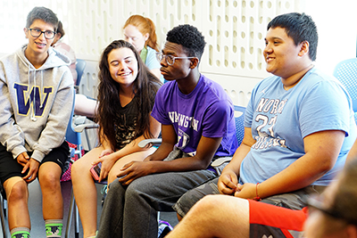
Neuroscience for Neurodiverse Learners
Hands-on experiences in neuroscience disciplines, networking opportunities, and resources to high school and early postsecondary students.
Resources for educators and stakeholders:
Website, knowledge base, workshops, publications.
Notes:
SCOTT

Slide 5
Summer Engagement Overview
Introduction to neuroscience and neural engineering, neuroethics.
Scientific communication
Social skills and teamwork
College preparation (STEM)
Notes:
SCOTT

Slide 6
Universal Design vs Accommodations
Universal design is the process of creating environments, activities, and products that are accessible to people with a wide range of abilities, disabilities, and other characteristics.
Accommodations vs. universal design
Notes:
SCOTT

Slide 7
Universal Design & Summer Camp
Hybrid nature of summer program
Dedicated spaces for reflection and quiet
Social narrative delivered prior to camp
Physically accessible rooms, labs, & buildings
Staff trained to provide support
Materials available in a variety of formats
Captioned videos and videoconferencing
Offer multiple ways to engage content
Notes:
SCOTT

Slide 8
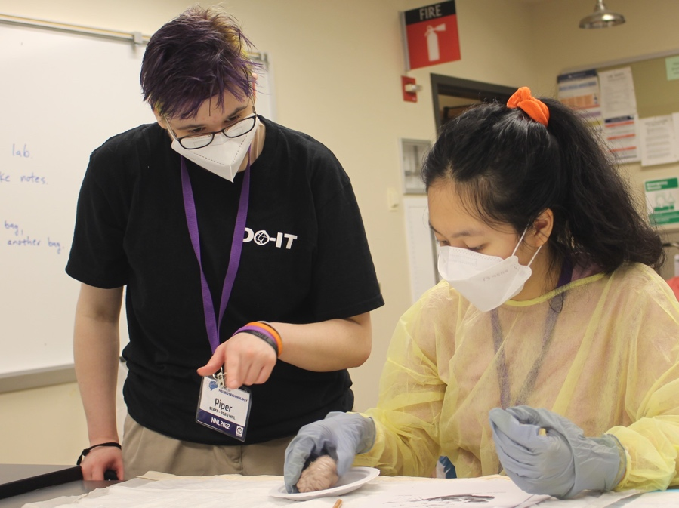
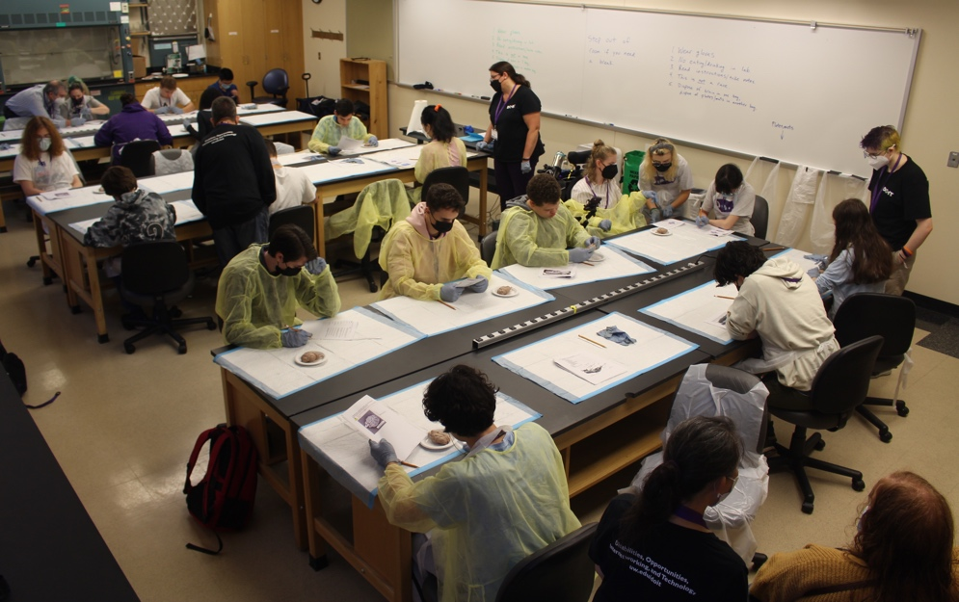
Example: Offering Options to Students
Those not wanting
to dissect a sheep brain were offered an alternative.
They could select a small group learning experience with digital content on a laptop.
Notes:
SCOTT

Slide 9
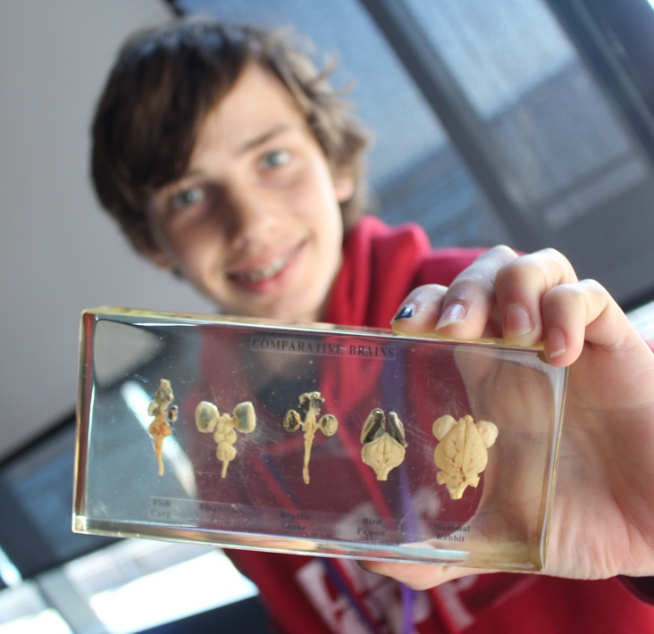
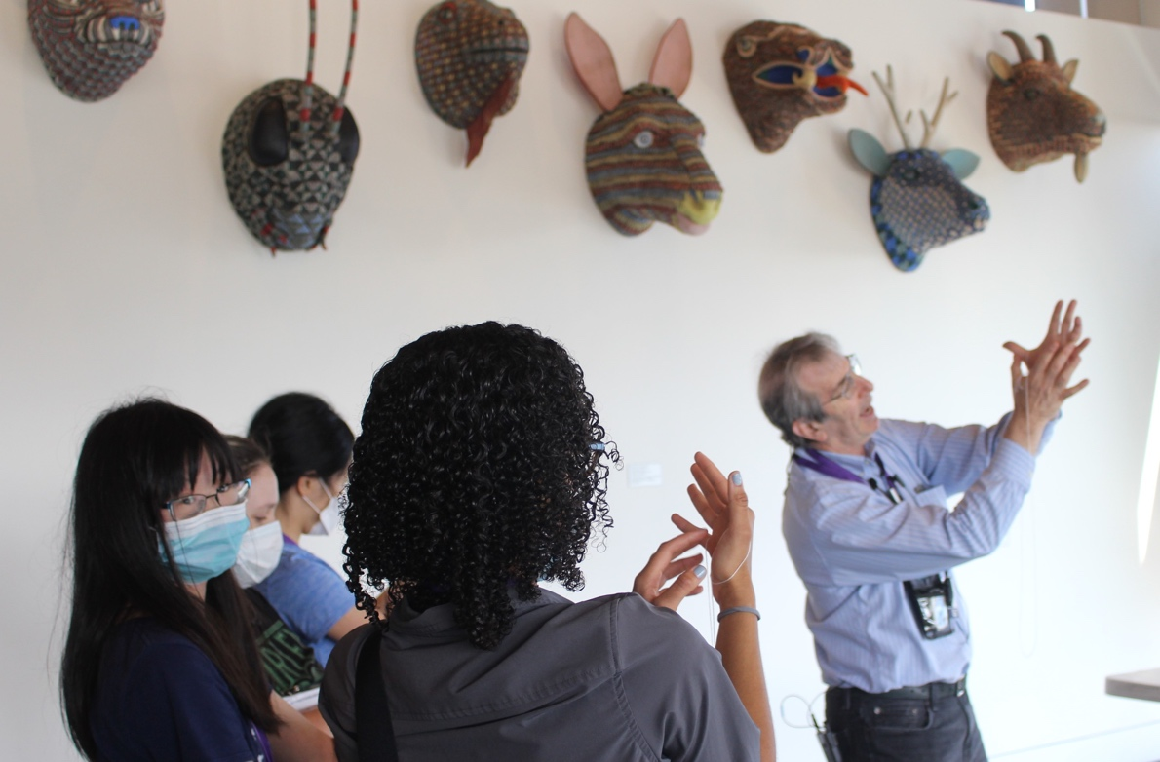
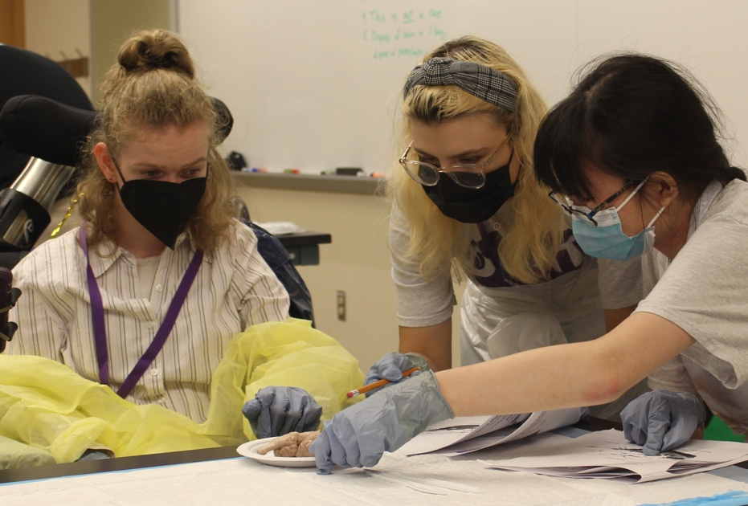
The Importance of Hands-On Learning
Hands-on learning and multiple ways to engage content are critical for engaging all learners
Notes:
SCOTT

Slide 10
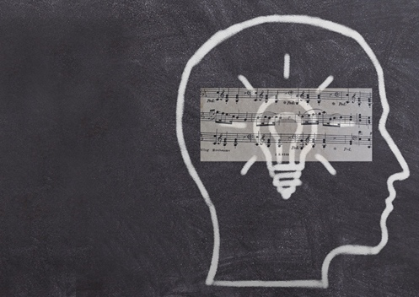
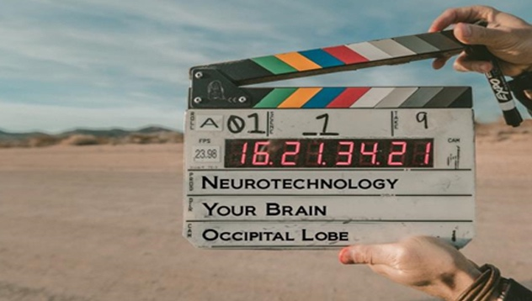
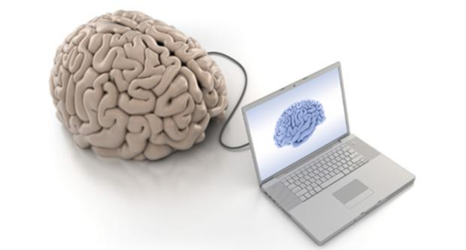
Examples of Student-Driven Content
Meditation, Mindfulness and the Brain
Music and the Brain
Neuroethics
Neuroscience in Movies
Notes:
SCOTT

Slide 11
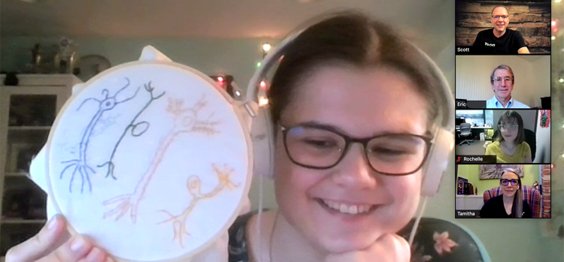
Near Peer Leaders
Help develop schedule and prepare examples
Participate in online discussions (Canvas LMS)
Lead panels and breakout rooms
Encourage everyone to celebrate student strengths
Lead by example and help create group norms
Notes:
SCOTT

Slide 12
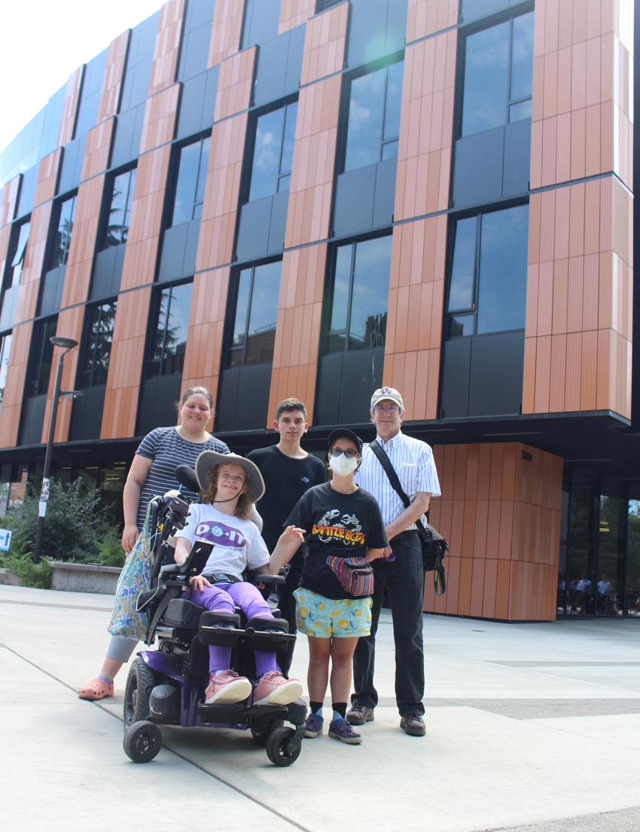
Assistive Tech & Summer Camp (1)
Students are asked about the use of AT prior to camp.
One or more meetings with an AT specialist.
Notes:
SCOTT
These students pictured with Dr. Chudler all use assistive technology (wheelchair, 3 smart pen, cochlear implant)

Slide 13
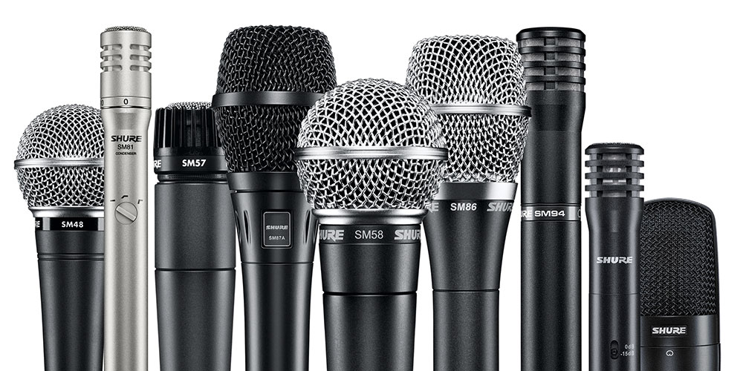
Assistive Tech & Summer Camp (2)
Multiple audio outputs from instructors, with dedicated streams for…
the classroom,
a cochlear implant user,
a user of hearing aids, and
the livestream audience on Zoom.

Slide 14
Assistive Tech & Summer Camp (3)
Students offered opportunities
to try various AT products for
the first time.
Smart Pen technology for note taking:
In-person training from a peer (college student) and AT staff during summer camp.
Six students requested Smart Pen products for use during the academic year.
Notes:
SCOTT

Slide 15
Assistive Tech & Summer Camp (4)
Note taking
software and apps:
Students learned about products and offered funding to install on their computers
Two students requested funding and year-round support
Notes:
SCOTT

Slide 16
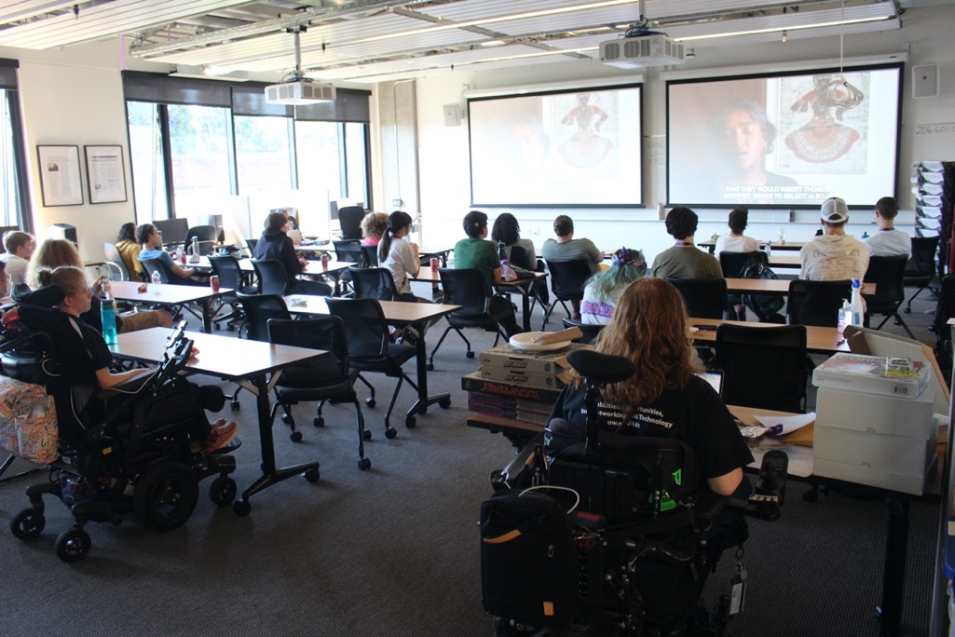
Assistive Tech & Summer Camp (5)
Summer camp sessions devoted to exploring AT commonly used by neurodivergent learners, especially in the areas of
note taking,
organizing ideas,
reading,
writing, and
mathematics.
Notes:
SCOTT

Slide 17
INCLUDES and AISL
DYNA STEM: Discover Your Neurodiverse Advantage in STEM (NSF INCLUDES Planning Grant #2040736)
Research Synthesis of Effective Inclusion Practices for Neurodiverse K-12 Learners in Informal STEM Learning Contexts (AISL # 2115542
Notes:
RONDA

Slide 18
DYNA STEM: INCLUDES Planning
Voices of 21 neurodiverse undergraduate students in STEM
3 states: Arizona, Missouri, Ohio
Notes:
RONDA

Slide 19
What do neurodiverse students tell us about their learning?
Time: I need more time and the time of day matters
Environments: Not all settings are conducive to my learning
Self-guided learning: Need to use my own strategies for teaching myself
Social aspects: Navigating group assignments can be tricky to nearly impossible without guidance; but that doesn’t mean I don’t want to do group activities.
Social aspects: I am aware that I think differently, but that doesn’t make me less capable.
Notes:
RONDA

Slide 20
Neurodiverse students tell us they want…
Specific, clear instructions
Flexibility for self-guided learning
Balance of peer learning, hands-on, and direct instructions (aka-not just lecture or not just group project)
Choice: Options to choose and not choose activities or steps
Visuals and graphics, not just text-based
Notes:
RONDA
10 items. How many of those 10 items are also good for you?

Slide 21
Neurodiverse students tell us they want (continued)…
Opportunities to be creative
Clear, logical applications to real-world STEM work
Sensory stimuli focused on specific tasks
Physical space options for standing and sitting, with options for orientation in the space
Clear social expectations
Notes:
RONDA
10 items. How many of those 10 items are also good for you?

Slide 22
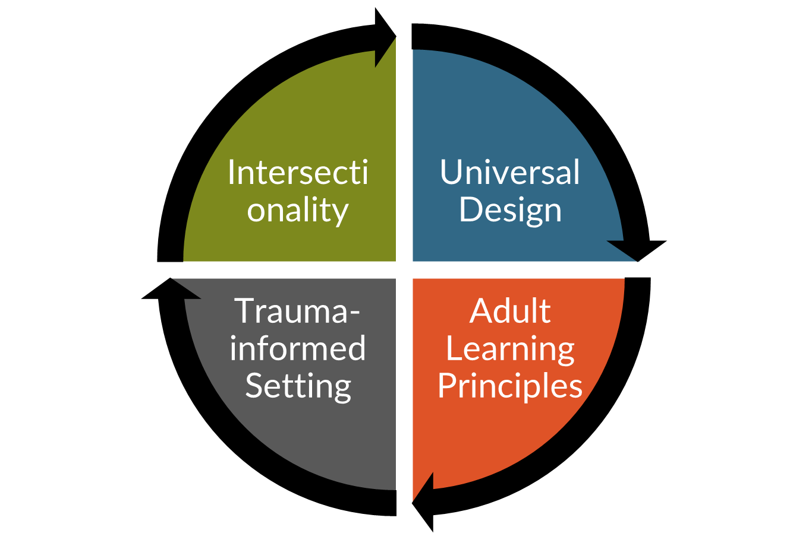
Elevating neurodiversity as diversity in the college classroom: Model approach
Acknowledge undergraduate students as adult learners who bring diverse learning histories to the classroom.
Acknowledge that learning histories may be positive, negative, or indifferent.
Acknowledge the intersectionality of cultural backgrounds, identities, and personal histories.
Acknowledge differences in the ways undergraduate students perceive, approach, and interact with new information and skills.

Slide 23
Effective Inclusion Practices for Neurodiverse Children and Adolescents in Informal STEM Learning: A Systematic Review
What characteristics of informal learning experiences correlate with increased STEM identity, self-efficacy, interest, and learning in neurodiverse K-12 students?
Notes:
RONDA

Slide 24
Systematic Search process
Records identified
Publication databases: 1,321
Other sources: 1,965
Records assessed for eligibility: 263
Total products: 19
11 studies (peer-reviewed publications)
8 artifacts (evaluation reports and supplemental documents)
Program sample sizes ranged from a case study to 400 participants
Notes:
RONDA

Slide 25
Results: Successful Programmatic Elements of Informal STEM Programs
Environment/ learning structure
Engagement
Agency
Creativity
Learning supports
Mentoring
Accommodations/modifications
Learning Activities
Collaborative learning
Real world application
Use of technology
Notes:
RONDA

Slide 26
Questions and Discussion
Ronda Jenson
Ronda.Jenson@nau.edu
Scott Bellman
swb3@uw.edu
Notes:
RONDA & SCOTT
WE SHOULD HAVE ABOUT 15-20 MINUTES FOR QUESTIONS

