Slide 1
Elevating neurodiversity as diversity in postsecondary undergraduate stem education
Ronda Jenson, PhD |Associate Professor |Research Director
Michele Lee, MS |Research Associate
Kelly Roberts, PhD |Professor |Executive Director
Institute for Human Development
Northern Arizona University
38th Annual Pacific Rim International Conference on Disability and Diversity
March 2023

Slide 2
DYNA STEM: Discover Your Neurodiverse Advantage in STEM Research Synthesis of Effective Inclusion Practices for Neurodiverse K-12 Learners in Informal STEM Learning Contexts
NSF INCLUDES Alliance: The Alliance of Students with Disabilities for Inclusion, Networking, and Transition Opportunities in STEM (TAPDINTO-STEM)
NAU: Mountain Hub Lead
Supported by the National Science Foundation under NSF Award #2040736 (NSF INCLUDES Planning Grant), Award # 2115542 (NSF AISL Grant), and subaward to Award #2119902 (NSF INCLUDES Alliance). Any opinions, findings, and conclusions or recommendations expressed in this material are those of the author(s) and do not necessarily reflect those of the National Science Foundation.
Notes:
Recognition of NSF awards
Brief description of projects and data informing this presentation
Recognition of project partners

Slide 3
What is neurodiversity?
Natural human variation
Neurodivergence is diversity
Neurodivergent thinking includes
autism,
many forms of learning disabilities such as dyslexia,
conditions that affect focus and maintaining engagement often referred to as attention deficit disorders, and
sometimes mental health conditions such as anxiety and depression
Notes:
Defining DYNA STEM and neurodiverse learners (define). What is meant by advantage?
Person-first/Identify-first language, neurodiversity is considered a natural, human variation

Slide 4
Disability/neurodiversity and DEI
Early stages of a review of university diversity, equity, and inclusion (DEI) strategic plans
Reviewed the DEI strategic plans for the 25 TAPDINTO-STEM partners
6 mention of (dis)ability in their DEI definition

Slide 5
Disability and DEI Examples
Examples
College A: The complexity of personal experiences, values, and worldviews that arise from differences and intersections of culture and circumstance. Such differences and intersections include race, sex, ethnicity, age, religion, language, ability/disability, sexual orientation, gender identity and expression, socioeconomic, veteran or other status, or geographic region.
College B: Diversity encompasses the whole of human experience and includes such human qualities as race, gender, ethnicity, physical ability, nationality, age, religion, sexual orientation, economic status and veteran status. These and other socially and historically important attributes reflect the complexity of our increasingly diverse student body, local community and national population

Slide 6
Broad definition of STEM
Fields of study and work that incorporate elements of science, technology, engineering, and/or math

Slide 7
Why increase neurodiversity in stem?
STEM careers need a diverse workforce in order to truly perceive the world’s STEM challenges and solutions
Creative thinking leads to innovation
Neurodivergent thinkers often notice things that non-divergent thinkers overlook, miss, or do not see at all
Increase employment opportunities for people with diverse abilities

Slide 8
DYNA STEM: INCLUDES Planning
Interviews with 25 Undergraduate STEM students from Northern Arizona University, University of Missouri-Kansas City, and Ohio State University.
Notes:
One on One Interviews with the following groups (N=43)
Neurodiverse Students in STEM (N=25) from the following Institutions:
Northern Arizona University, UMKC, Ohio State University
Campus support staff (disability support staff) (n=8)
STEM faculty (n=5)
Other campus support staff (librarians, advisors n=3)
STEM business (n=1)
Individuals with NSF funded research (n=2)
For students, we asked questions about accommodations that have been given that were beneficial, other beneficial services/supports) that have been used (e.g., tutoring) as well as opportunities to be mentored. Interviews lasted between half and hour to an hour.
For Disability support staff we asked: What accommodations were effective in helping neurodiverse students succeed in STEM coursework?
Coding and Analysis:
We utilized a bottom up approach, allowing codes to emerge from the data.
A code book as used to organize the constructs, definitions, and was revised multiple times during the analysis phase.
Three researchers were involved in coding.

Slide 9
What did neurodiverse students tell us about their learning?
Time: I need more time and the time-of-day matters
Environments: Not all settings are conducive to my learning and work
Self-guided learning: Need to use my own strategies for teaching myself
Social aspects: Navigating group tasks can be tricky to nearly impossible without guidance; but that doesn’t mean I don’t want to do group tasks.
Competency: I am aware that I think differently, but that doesn’t make me less capable.

Slide 10
Preparation for learning
Think about task you were recently assigned to figure out and complete with your team. Or think about a neurodiverse student or coworker you know.
Refresh your memory on the requirements of the task.
What were the steps toward completion?
What resources were needed?
What knowledge and skills were you and others expected to be able to do?
How was feedback provided?

Slide 11
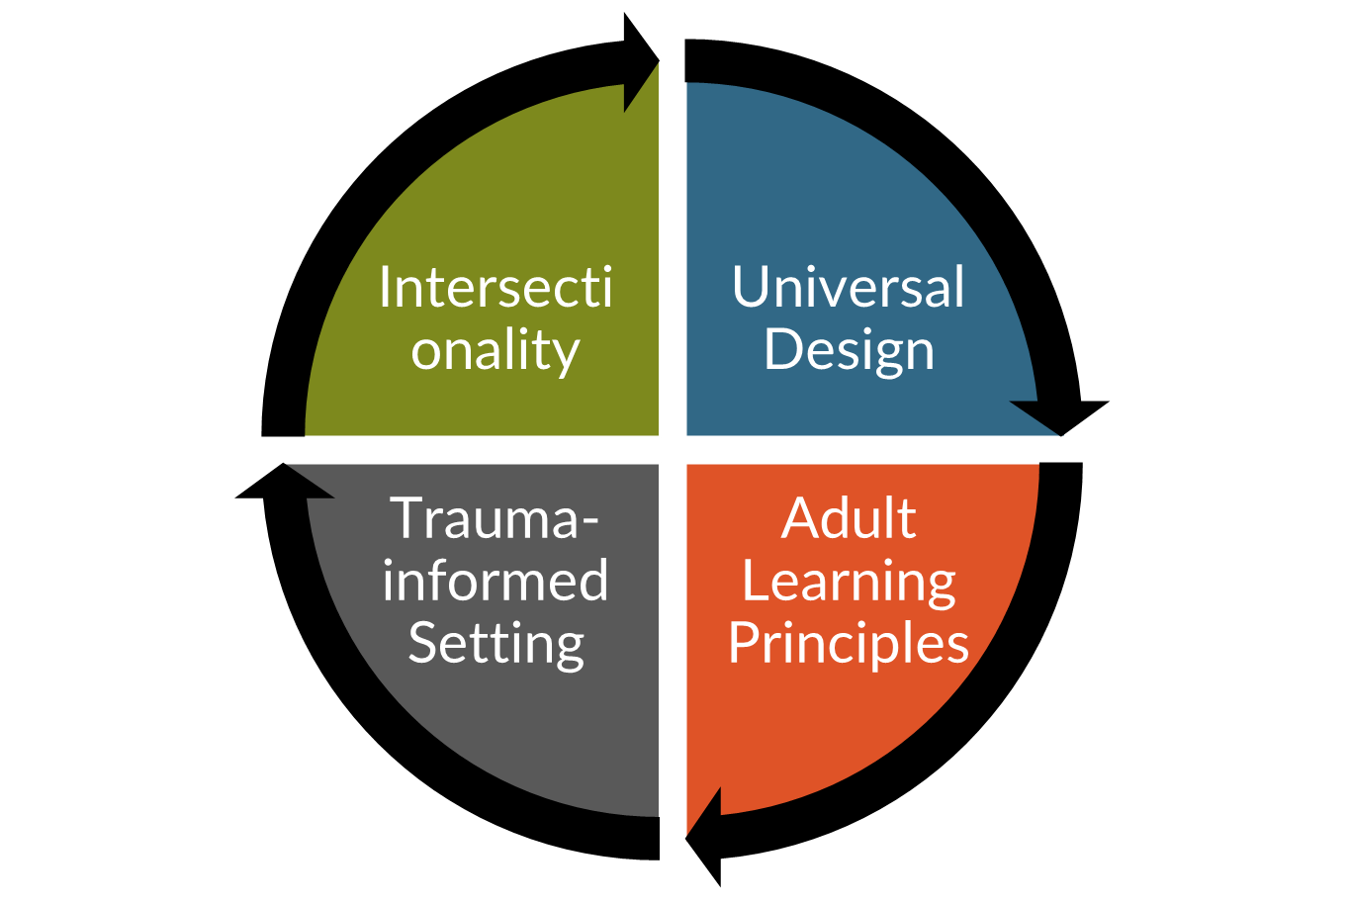
Elevating neurodiversity/diversity in the college classroom
Acknowledge undergraduate students as adult learners who bring diverse learning histories to the classroom.
Acknowledge that learning histories may be positive, negative, or indifferent.
Acknowledge the intersectionality of cultural backgrounds, identities, and personal histories.
Acknowledge differences in the ways undergraduate students perceive, approach, and interact with new information and skills.

Slide 12
Neurodiverse students tell us they want…
Specific, clear instructions
Flexibility for self-guided learning
Balance of peer learning, hands-on, and direct instructions (aka-not just lecture or not just group project)
Choice: Options to choose and not choose activities or steps
Visuals and graphics, not just text-based
Notes:
10 items. How many of those 10 items are also good for you?

Slide 13
Neurodiverse students tell us they want…
Opportunities to be creative
Clear, logical applications to real-world STEM work
Sensory stimuli focused on specific tasks
Physical space options for standing and sitting, with options for orientation in the space
Clear social expectations
Notes:
10 items. How many of those 10 items are also good for you?

Slide 14
Discussion/Reflection Questions
What are examples of strengths and unique perspectives that neurodiverse individuals bring to the STEM education and careers?
What steps and advocacy are needed in order broaden DEI mindsets and strategic plans to include (dis)ability?

Slide 15
Thank you.
Ronda Jenson, PhD
Ronda.Jenson@NAU.edu
@rondajenson
https://www.linkedin.com/in/rondajenson
Contact information
Michele Lee, MS
Michele.Lee@NAU.edu
@micheleskylee
https://www.linkedin.com/in/michele-lee-55a17157
Kelly Roberts, PhD
Kelly.Roberts@NAU.edu
38th Annual Pacific Rim International Conference on Disability and Diversity
March 2023

